Slide 1

STATISTICAL
FORECAST METHODS
EXPLORED
Seasonal Naïve (with Growth)
Exponential State Space
ARIMA
Neural Networks
Theta Forecasting
Seasonal Decomposition

Slide 2
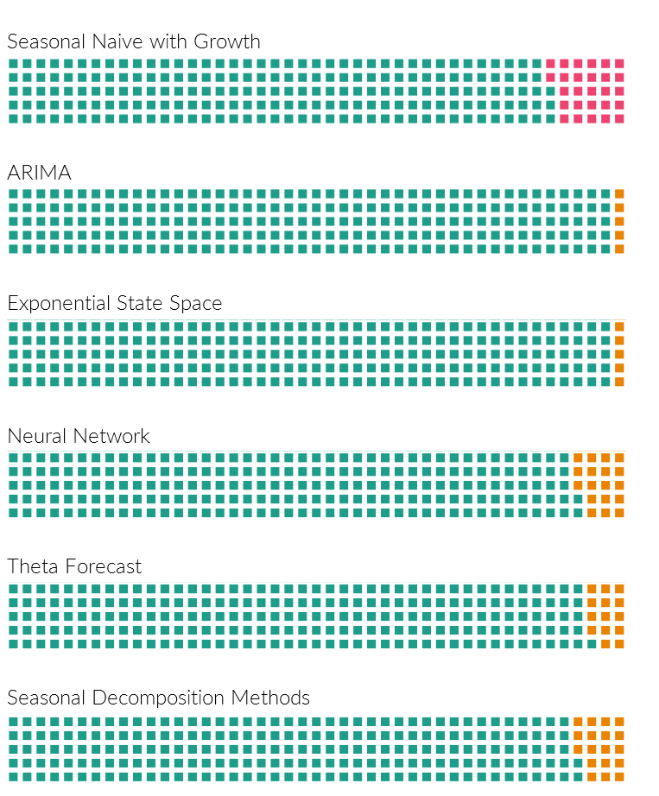


COVERAGE
How much of the items are forecasted under each methods?
Forecasted using the method
Forecasted not using the method because of technical reasons, but forecasted by an alternate methods.
Not Forecasted at all
Seasonal Naïve with Growth
Has 12% missing forecasts because of the inherent mechanism which mandates 18 months data for forecasting.
Statistical Methods
Has 0% missing forecasts because they use backup methods in case the regular method cannot be applied.
Any series with less than 24 months of data, seasonality rules are not applied
Any series with less than 3 months of data, Neural networks are not applied
But, in all those cases, we apply a non-seasonal method to cover up.

Slide 3
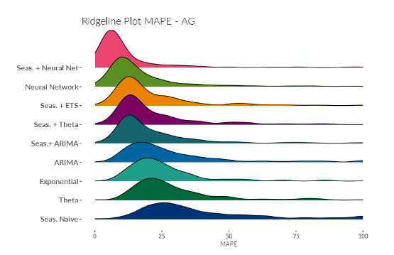
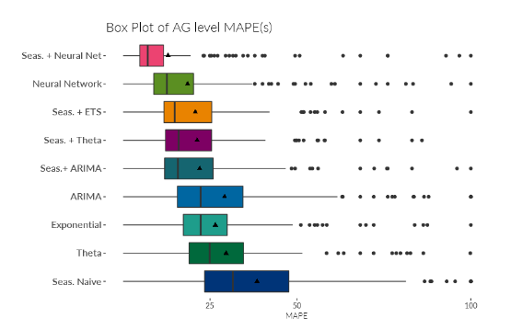
How to read the plot:
Leftward Peak is Good. Shows better accuracy.
Narrow Shape is Better. Shows a forecasting method does equally well across all AGs.
FORECASTING
VARIANCE
Seasonal Naïve with Growth
Has quite a flat ridge line and wide box plot. Shows the performance hugely varies between different AGs.
Neural Network with Seasonal Decomposition
How to read the plot:
Vertical Black Line shows the Median and the Black triangular dot shows the Mean.
Black Dots are the outliers. Shows the AGs which are performing quite badly as compared to other AGs.
The method which shows the least variability among all methods.
Exponential Smoothing Methods
ETS also shows a thin box in the Box Plot, better than ARIMA. Seasonal ETS shows marginally wider box, but better overall accuracy.

Slide 4
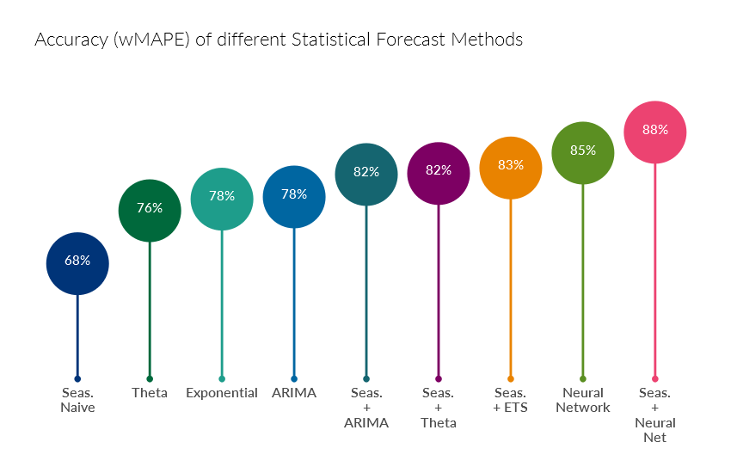
Statistical Forecast Methods - Performance
Accuracy calculated from a weighted MAPE at an AG level.
+ 88%
Highest Accuracy is observed in Neural Networks which was applied along with Seasonal Decomposition.
+ 83%
Exponential Smoothing applied along with Seasonal Decomposition also showed a good accuracy. This is much less complex and can be explained more easily than Neural Networks.
+ 68%
The benchmark score of the existing method (Seasonal Naïve with Growth)

Slide 5
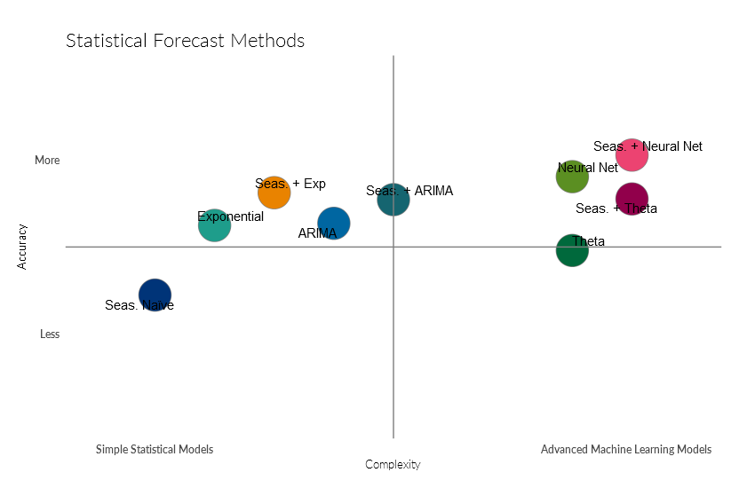
Statistical Forecasting Methods vs Complexity
A comparison of different methodologies along with the complexity involved.
Advanced Machine Learning models provide better forecast accuracies, but because of the complexity involved, adoption of the methods may be less.
Therefore we need to balance the gain in accuracy with the increase in complexity to select the best model.

Slide 6
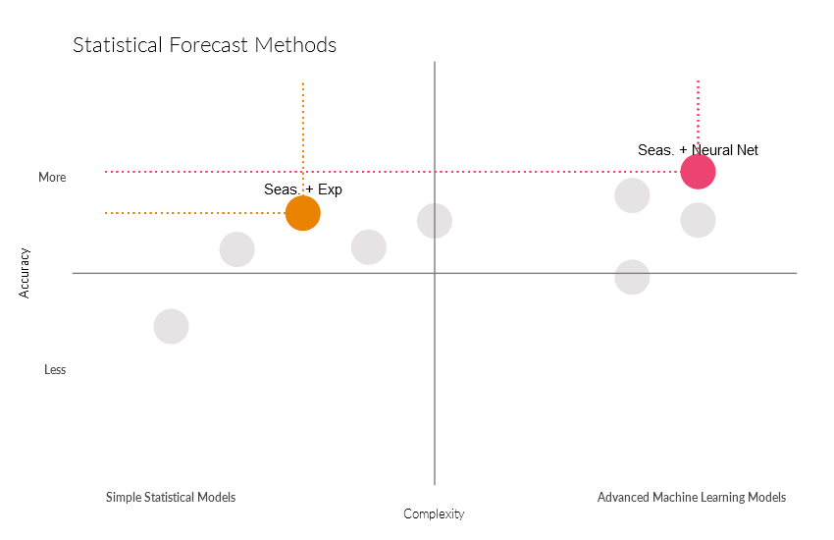
Statistical Forecasting Methods vs Complexity
Choosing a Model
Chosen Model
Seasonal Decomposition with Exponential State Space models.
Increase in Complexity
Separate the Demand into Trend, Seasonality.
Apply the Exponential State Space model optimization to the Trend component.
Close to 15 Models are tried and the one with the minimum error is chosen.
Add back the Seasonality to get the forecast.
Improvement in
Accuracy
Comparison with Top Performing Model
5%
60
83%
Increase in Accuracy
Increase in Complexity
Overall Accuracy

Slide 7

APPENDIX

Slide 8
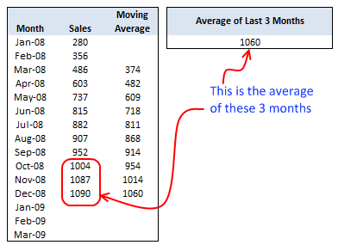
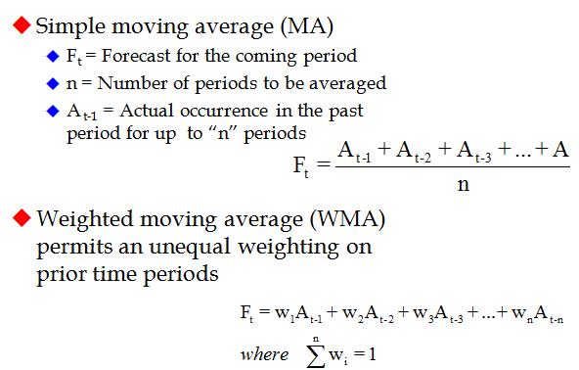
Moving Averages are one of the most simplistic methods for forecasting. It just takes an average on a rolling n window and concludes that is the forecast for the future periods.
The image on the left shows the calculation of a 3 month moving average.
MOVING
AVERAGES
Weighted Moving Average is just adding one more dimension on top of the moving average. While the moving average gives equal weightage to all the n observations, in the Weighted Moving average, we are able to set weightages for the observations. By tweaking this weightage, we can give more or less importance to recent observations.

Slide 9
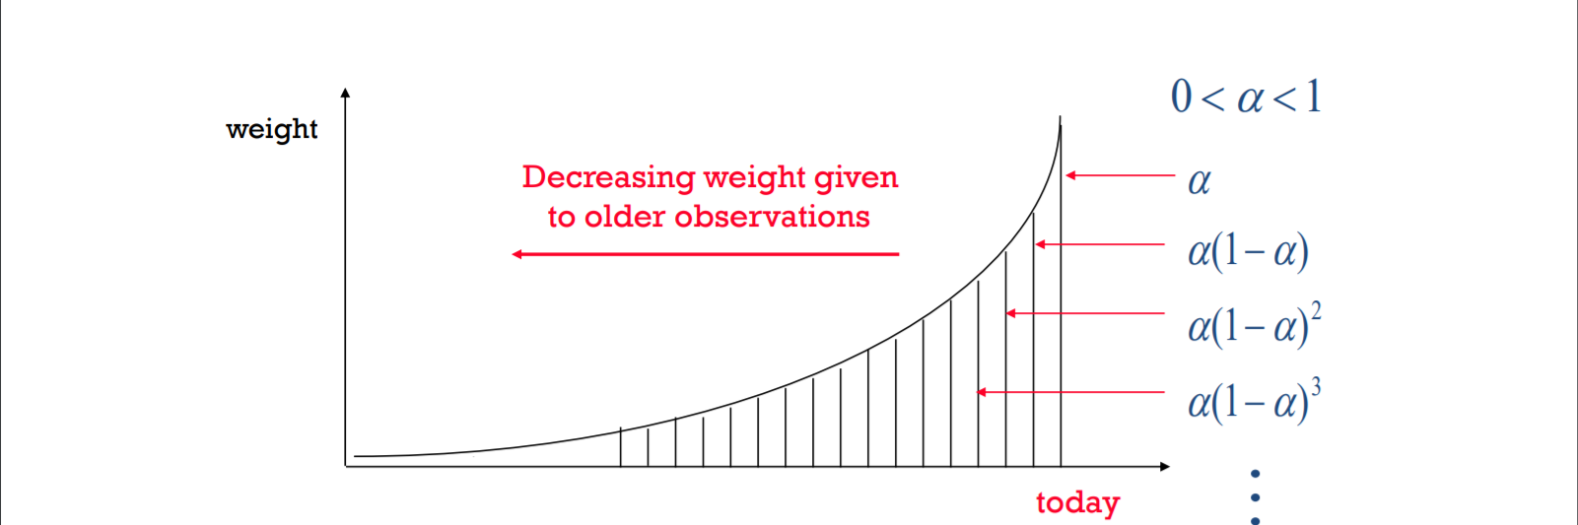
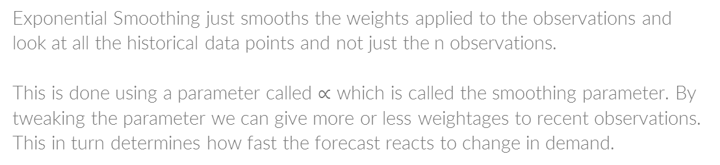
Exponential Smoothing
Exponential Smoothing just smooths the weights applied to the observations and look at all the historical data points and not just the n observations.
This is done using a parameter called $∝$ which is called the smoothing parameter. By tweaking the parameter we can give more or less weightages to recent observations. This in turn determines how fast the forecast reacts to change in demand.

Slide 10
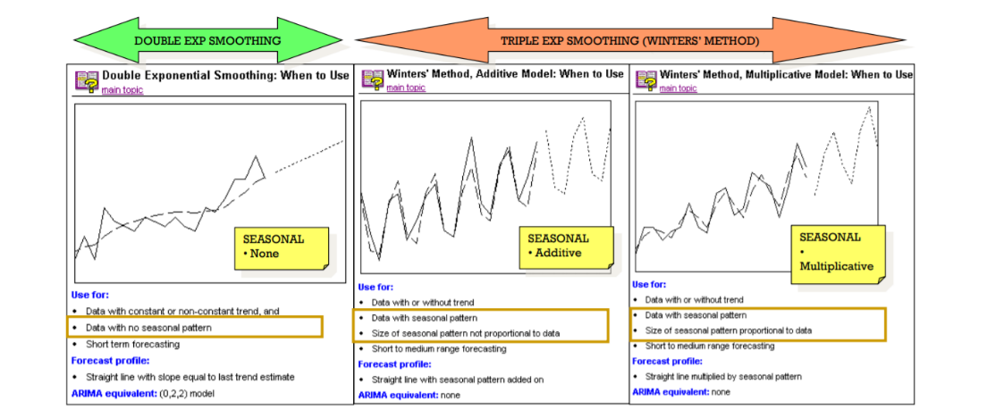
Exponential Smoothing
More Complicated Models
For different type of demand, there are slightly more complicated models which forecasts them. A few are below:

Slide 11
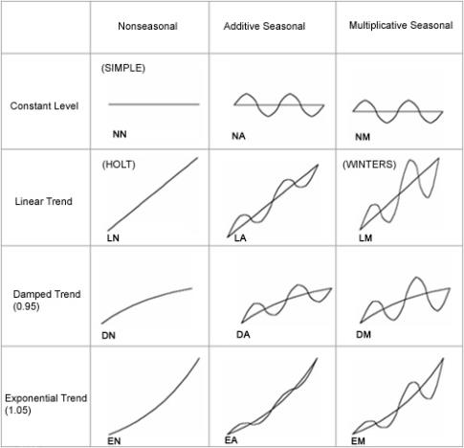
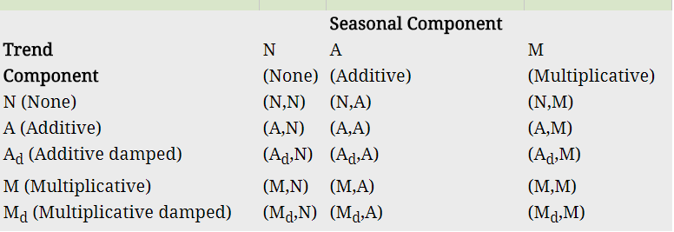
Exponential Smoothing
State Space Optimization
There are different assumptions and variations in the different aspects of Exponential Smoothing that with all the different combinations, we have about 15 different models. The State Space Optimization finds out the best model to be used by evaluating all the models and selects the best one.

